Slide 1
Student Name : Kavuru Lakshmi Tanmai
Project Name : KEY LOGGER AND SECURITY
-Understanding the Threat and how to protect against it

Slide 2
Problem Statement:
Keyloggers, malicious software that surreptitiously records every keystroke, pose a critical threat to our digital security. By capturing sensitive information like passwords and credit card numbers, they open the door to financial fraud and identity theft. This infiltration not only exposes our personal data but also breaches the privacy of our online activities, including messages and browsing history. Furthermore, keyloggers endanger businesses by potentially stealing access credentials to corporate networks, jeopardizing sensitive data, and causing financial losses. The difficulty in detecting these stealthy programs and the continuous evolution of new strains by malicious actors necessitates the development of robust solutions to safeguard our data and privacy.

Slide 3


Table of Contents
Introduction to Keyloggers
How keyloggers work
Methods of Keylogger Distribution
Detection and Prevention
Your solution and its value proposition
Security
Modelling
Advantages, Disadvantages and Algorithm
Results

Slide 4
INTRODUCTION TO KEYLOGGER :
Keyloggers - Keyloggers, like digital eavesdroppers, silently steal your keystrokes. These malicious programs capture sensitive data like passwords and credit card numbers, putting you at risk of financial fraud and identity theft. Be vigilant, as these silent thieves threaten your online security.
Security - Security is like a shield. It protects us from harm, whether it's physical danger, financial loss, or unwanted access to our information. We achieve security through various safeguards, like alarms for our homes or passwords for our data. Essentially, it's the feeling of safety and the actions we take to create it.

Slide 5
Types :
Software Keyloggers:
These are programs that are installed on your computer. They can be more difficult to detect than hardware keyloggers, but they are also more common. There are several different types of software keyloggers, including Kernel Mode, User Mode,
Web Based KeyLoggers
Hardware Keyloggers:
These are physical devices that are attached to your computer, usually between the keyboard and the computer itself. They can be difficult to detect because they are not software programs running on your computer.

Slide 6
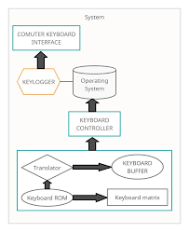
HOW KEYLOGGERS WORK?
Keyloggers function like stealthy spies in the digital realm. Hardware variants require physical access and sit between your keyboard and computer, intercepting keystrokes. Software keyloggers, disguised or delivered through malicious links, operate similarly. Once installed, they act as middlemen, capturing every keystroke you press before it reaches its intended program. This stolen data, including passwords, credit card information, and messages, is then stored on the device or transmitted to the attacker's remote location. This silent thievery puts your online security at great risk, as keyloggers can steal your most sensitive information without you ever noticing.

Slide 7

METHODS OF KEYLOGGER DISTRIBUTION :
Phishing Emails: Deceptive emails disguised as legitimate sources (banks, social media platforms) trick you into
downloading infected attachments or clicking malicious links. These attachments or links
can harbor software keyloggers.
Malicious Downloads: Software disguised as free utilities, games, or even pirated content might be bundled with keyloggers.
Once downloaded and installed, the keylogger operates in the background.
Drive-by Downloads: By simply visiting a compromised website, malicious code can exploit vulnerabilities in your browser and
download a keylogger onto your device without your knowledge.
Social Engineering: Deception tactics like fake online surveys or social media quizzes can lure you into downloading a keylogger
disguised as a necessary component to participate.
Physical Access: In rare cases, physical access to your device can be exploited. A hardware keylogger, a tiny device attached
between your keyboard and computer, can be installed to steal your keystrokes directly.

Slide 8

DETECTION AND PREVENTION :
Detection : Detecting keyloggers requires a combination of methods including using anti-malware software, conducting regular security scans, and implementing behavioral monitoring. These approaches help in identifying and mitigating the risks associated with keylogging malware.
Anti-Malware Software
Regular Security Scans
Behavioral Monitoring
Prevention :Preventing keyloggers involves adopting proactive measures such as practicing safe internet habits, regularly updating software, and employing encryption technologies. These steps help mitigate the risks of unauthorized keystroke monitoring and data theft.
Use Virtual Keyboards
Multi-Factor Authentication (MFA)
Monitor System Activity
3/21/2024 Annual Review

Slide 9
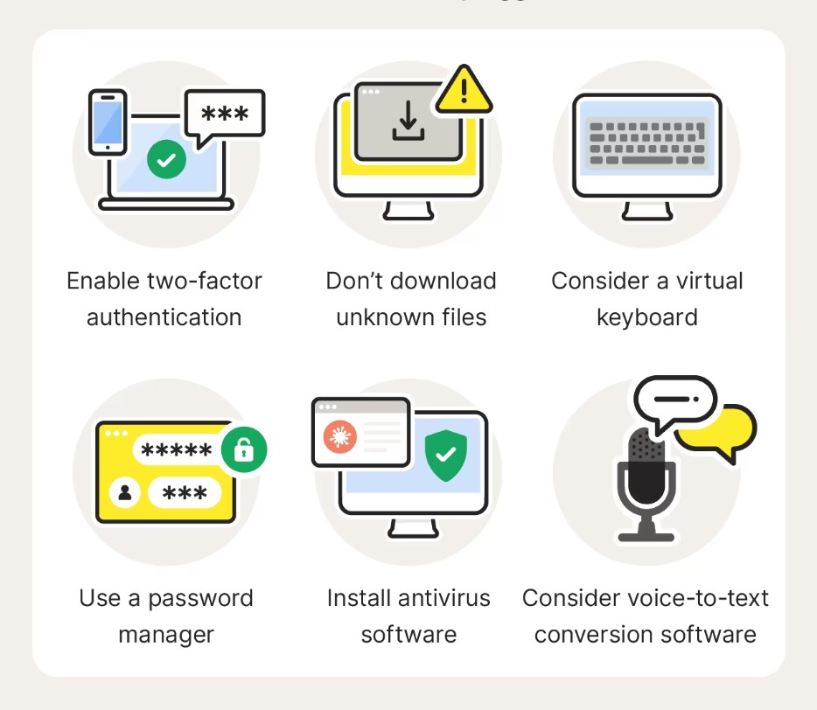
YOUR SOLUTION AND ITS VALUE PROPOSITION
Our solution focuses on implementing comprehensive prevention strategies to safeguard against keyloggers, ensuring robust protection for sensitive information and systems. By adopting our solution, organizations can effectively mitigate the risks associated with keyloggers, uphold data integrity, and maintain trust with stakeholders.
Advanced Anti-Malware Software
Behavioral Monitoring and Anomaly Detection
Encryption Technologies
Regular Security Audits and Updates
Comprehensive Protection
Adaptability and Scalability

Slide 10

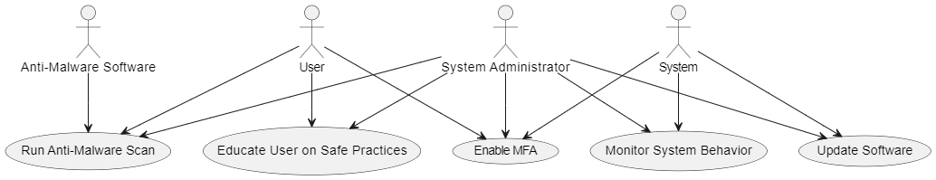
Use-case diagram:
SECURITY:
Combating keyloggers requires a layered security approach, building a fortress to protect your data. First line of defense is a robust anti-malware solution, actively scanning for and eliminating these digital spies. Next, a patchwork defense is essential - keeping your operating system, applications, and firmware up-to-date with the latest security patches closes holes keyloggers might exploit. Multi-factor authentication (MFA) acts as a double-layered shield, requiring an extra step beyond your password to thwart unauthorized access. Empowering users through education on safe online habits and vigilant monitoring for unusual system activity further strengthens your defenses. By implementing these comprehensive security measures, you can create a secure environment that safeguards your sensitive information from keylogger attacks.
10

Slide 11
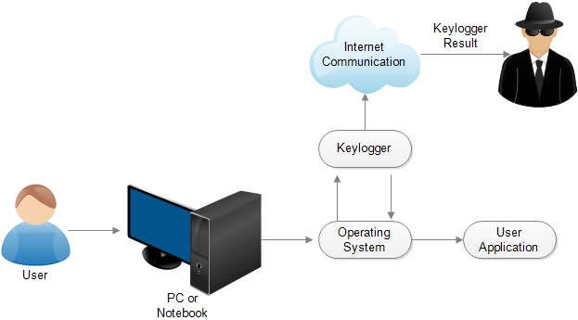
MODELLING :
END USERS:
Individuals: Concerned about personal data security and privacy.
Businesses: Need to protect corporate data and ensure compliance with security standards.
Organizations: Require robust security measures to safeguard sensitive information.
Security Professionals: Aim to understand and mitigate keylogging threats.
11

Slide 12
MODELLING:
Architecture Overview:
Modular Design: The keylogger code is structured into modular functions for better readability and maintenance.
Event Handling: Utilizes the pynput library to capture and handle keyboard events.
Data Logging: Implements functions to log captured data into text and JSON files.
Components:
Key Press Handling:
Function: on_press(key)
Description: Captures and logs the pressed keys.
Details: Appends key press events to a list and updates the JSON log file.
Key Release Handling:
Function: on_release(key)
Description: Captures and logs the released keys.
Details: Appends key release events to a list, updates the JSON log file, and accumulates keys for the text log.
12

Slide 13
Logging Functions:
Text Logging:
generate_text_log(key)
Description: Writes the recorded keys to key_log.txt.
JSON Logging:
generate_json_file(keys_used)
Description: Dumps the list of key events to key_log.json.
GUI Integration:
Tkinter Framework: Utilizes tkinter for creating a graphical user interface.
User Interaction:
Start Button: Initiates the keylogger.
Stop Button: Stops the keylogger.
Status Updates:
Provides real-time feedback on the status of the keylogger (running/stopped).

Slide 14
Flow Diagram:
Initialization:
Set up the main GUI window.
Initialize global variables for key logging.
Event Capture:
Start capturing key events when the "Start" button is pressed.
Log key press and release events.
Data Logging:
Continuously update text and JSON log files with captured key events.
Stop Logging:
Stop capturing key events when the "Stop" button is pressed.
Update the GUI status to indicate the keylogger is stopped.

Slide 15
ADVANTAGES & DISADVANTAGES
Advantages:
Monitoring and Surveillance
Parental Control
Password Recovery
Law Enforcement
Debugging
Disadvantages:
Privacy Concerns
Malware Threat
Legal Issues
False Sense of Security
Detection and Removal Challenges
ALGORITHMS
Form Grabbing
Memory Injection
Keyboard Hooks
API Hooking
Network-based Keylogging

Slide 16
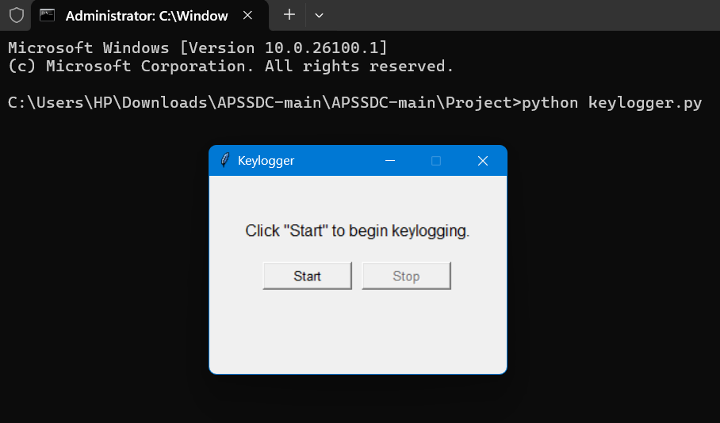
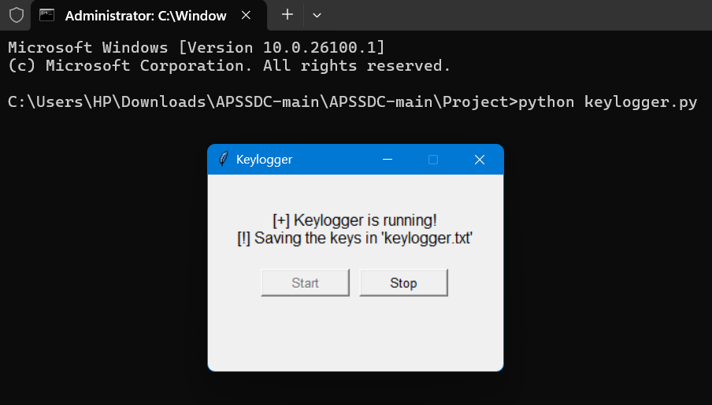
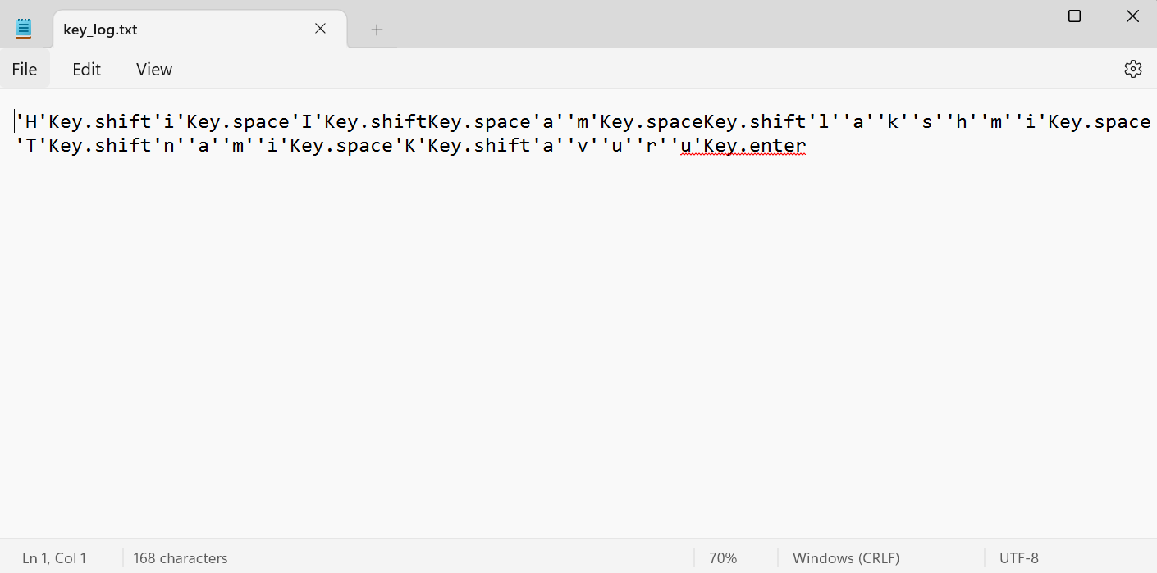
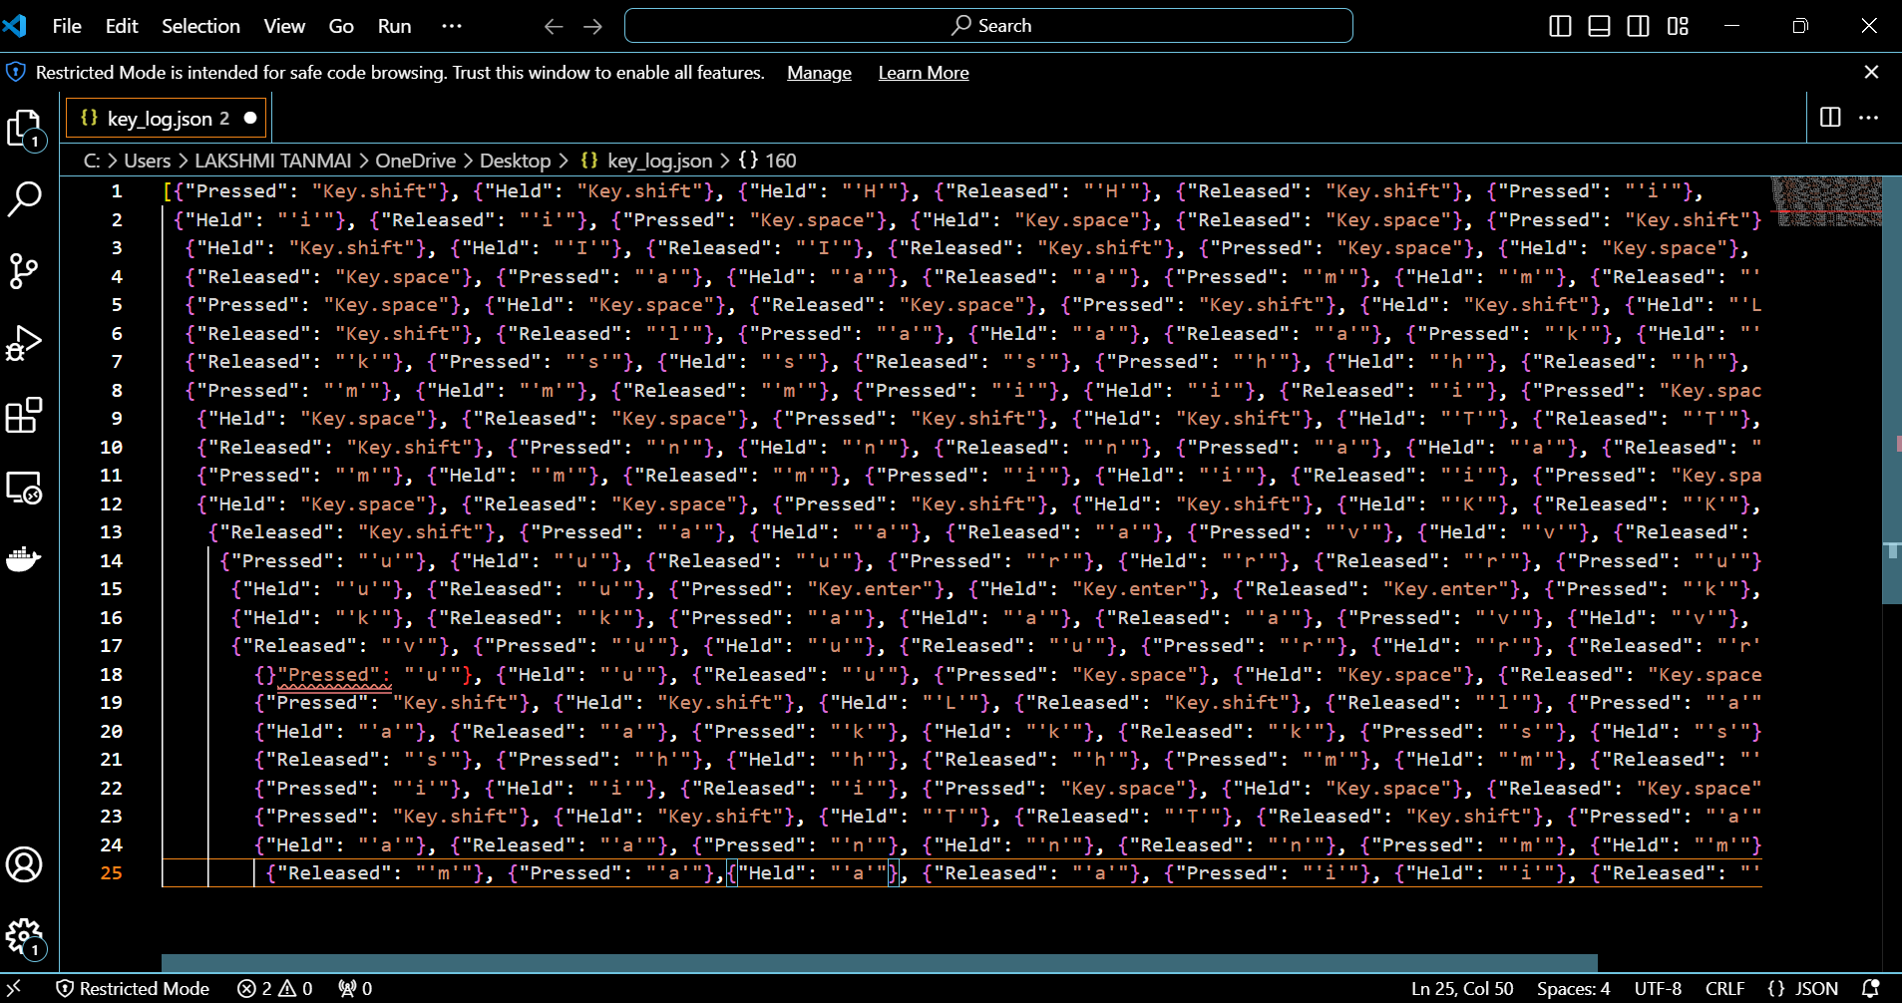
RESUL TS
Screenshots of the GUI: Display the user interface, including the start and stop buttons, and the status label.
Sample Logs: Show examples of the key_log.txt and key_log.json files to illustrate how the keystrokes are recorded.
16
16

Slide 17
Successfully implemented a keylogger that captures keystrokes and records them into both text and JSON files.
The keylogger project demonstrated the capability to effectively capture and log keystrokes in real-time.
The GUI provided a user-friendly way to control the keylogger, making it accessible and easy to use.
Emphasized the ethical use of keyloggers and the importance of implementing security measures to protect against malicious use.

Slide 18


